Slide 1

Lecture
on
“Advanced Computer Architecture –TCS 704”
by
Akansha Gupta
DEPARTMENT OF COMPUTER SCIENCE AND ENGINEERING
GRAPHIC ERA DEEMED TO BE UNIVERSITY – 248002

Slide 2
Virtual Memory

Slide 3
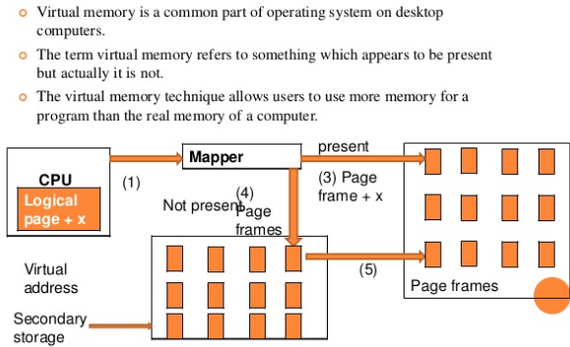
Virtual Memory

Slide 4
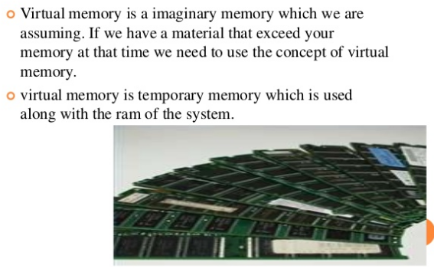
Need of Virtual Memory

Slide 5
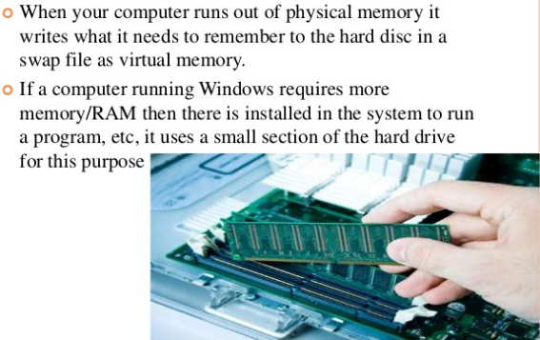
Importance of Virtual Memory

Slide 6
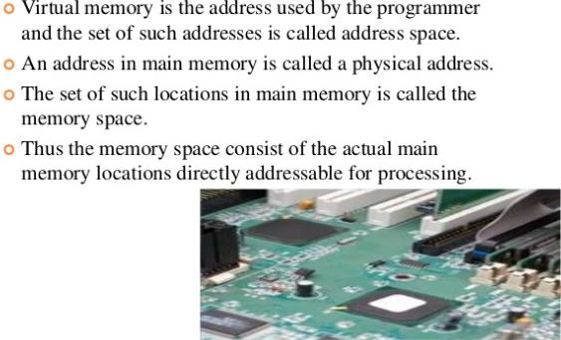
Address Space & Memory Space

Slide 7
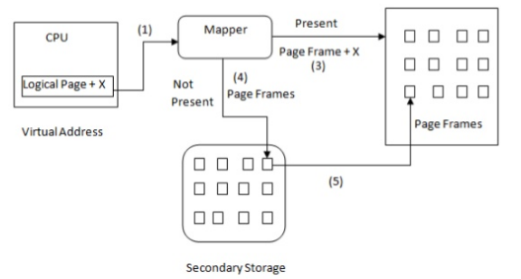
Virtual Memory

Slide 8
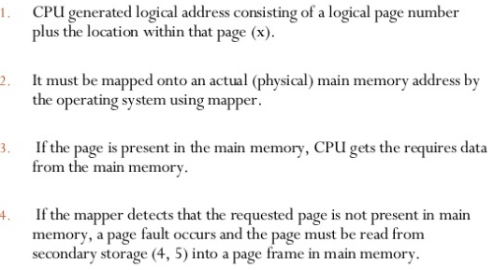
Cont…..

Slide 9
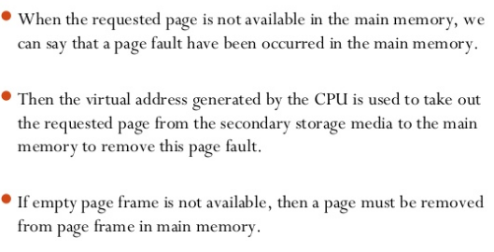
Address Mapping using Memory Mapping Page Table

Slide 10
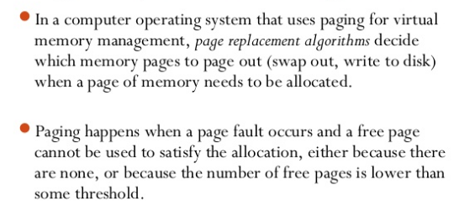
Page Replacement Algorithm

Slide 11
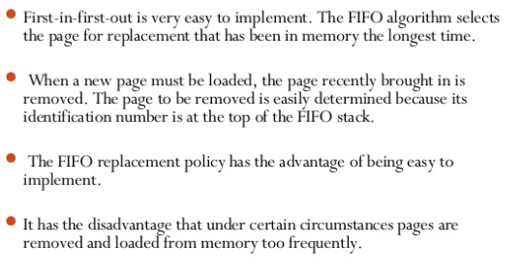
First-In-First-Out(FIFO)

Slide 12
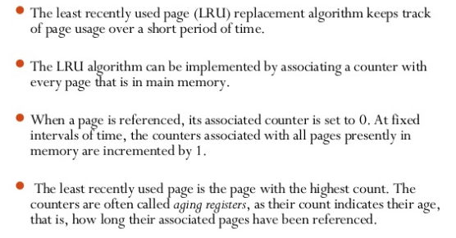
Least Recently Used(LRU)

Slide 13
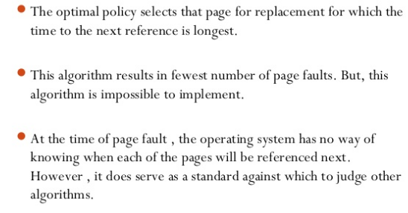
Optimal(OPT)

Slide 14
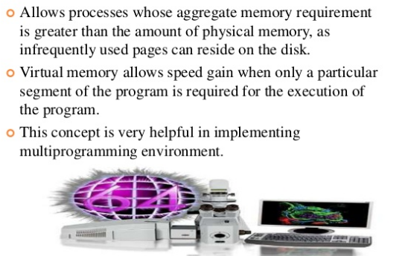
Advantages of Virtual Memory

Slide 15
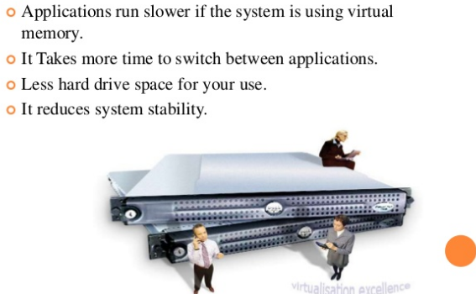
Disadvantages of Virtual Memory

Slide 16
https://youtu.be/aYGhs90HoLE
Thanks

